Slide 1
Coding-Proficient

Slide 2

Coding-Proficient
Coding Foundation - Summary
Writing code as per coding guidelines
Organizing the code sensibly
Abstract Data Types and Wrapper Functions
Tools for better programming
Editors
Debugger
Memory Analysis tools

Slide 3
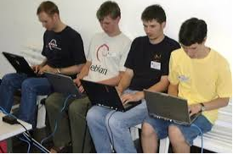
Coding-Proficient
Discussion!
How do you write code with zero errors in the first attempt?
(Why do I have to write code with zero errors in the first attempt ?!)

Slide 4

Coding-Proficient
Coding Proficient - Objectives
To be a better developer :
Code has zero errors in very first attempt
Cyclomatic complexity less than 10 for atleast 70% of code
Written code is easily debugged remotely
To be aware of already available libraries and to be able to use them efficiently
To be able to produce portable code
Notes:
Cyclomatic complexity of less than 10 is something they need to show in all the code they write.

Slide 5

Coding-Proficient
Coding
Here we go!
Notes:
Lets revisit this question.
Someone who codes as per design, to meet the requirements and creates a code which is highly maintainable and has no bugs. NO BUGS!

Slide 6
Coding-Proficient
Coding Advanced - Objectives
To be a better developer:
Code has zero errors in very first attempt
Cyclomatic complexity less than 10 for atleast 70% of code
Written code is easily debugged remotely
To be aware of already available libraries and to be able to use them efficiently
To be able to produce portable code

Slide 7

Coding-Proficient
Need to be a smart developer
Be aware of the latest tools & use them
Keep practicing. Type faster.
Work on open source projects.
Work with developers who are better than you. Pair program!
Code more consciously
"slow is smooth and smooth is fast"

Slide 8
Coding-Proficient
Useful vim plug-ins
Ctags
Cscope
autocomplete
Notes:
These are open source options. Show and tell – L&D trainer will enable the participants to access Linux and try out these tools.
Trainer may choose to list and practice on project specific tools

Slide 9
Coding-Proficient
ctags
Ctags
To quickly jump to definitions of functions, data structures etc.
Very useful aid for understanding and traversing code
How about some revision practice
Notes:
ctags *.h *.c This creates a file names "tags".
Update the “.vimrc” file with the absolute path of the tag file
Edit the file using vi.
Unix command line: vi -t subroutine_name This will find the correct file to edit.
OR
Vi command line: :tag subroutine_name This will jump from your current file to the file containing the subroutine. (short form :ta subroutine_name )
OR
By cursor position: ctrl-] Place cursor on the first character of the subroutine name and press ctrl-] This will jump to the file containing the subroutine.

Slide 10
Coding-Proficient
cscope
What cscope can do
Find C symbols
Find global definitions
Find functions called by give function
Find functions calling given function
Find given text string
Find a file
Find files #including a file:
Find all function definitions
Notes:
1. cd to the top-level of your project directory and then use a find command to gather up all of the source code files in your project. The following command will recursively find all of the .c, .cpp,.h, and .hpp files in your current directory and any subdirectories, and store the list of these filenames in cscope.files:
cd ~/small-project/ find . -name "*.c" -o -name "*.cpp" -o -name "*.h" -o -name "*.hpp" > cscope.files
Depending on your project, you can use additional file extensions in this command, such as .java, .py, .s, etc.
2. Now, pass the list of source files to Cscope, which will build a reference database:
cscope -q -R -b -i cscope.files
The -q flag is used to build a faster (but larger) database. -R tells Cscope to search for symbols recursively. -b builds the database only, but does not start the Cscope browser. -icscope.files specifies the list of source files. The output of this command will be a set of files in your current directory: cscope.in.out, cscope.out, and cscope.po.out.
Finally, start the Cscope browser:
cscope -d
The -d flag tells Cscope not to regenerate the database (which you already did in the previous step). Within the Cscope browser, type ? to see the help page, and type Ctrl-d to exit. The browser will show you a list of the searches you can perform in your code:
Find this C symbol:
Find this global definition:
Find functions called by this function:
Find functions calling this function:
Find this text string:
Change this text string:
Find this egrep pattern:
Find this file:
Find files #including this file:

Slide 11
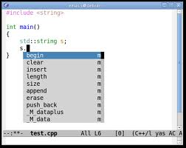
Coding-Proficient
Autocomplete with vim
Auto Complete with vim
Notes:
Just put:
filetype plugin on
au FileType php setl ofu=phpcomplete#CompletePHP
au FileType ruby,eruby setl ofu=rubycomplete#Complete
au FileType html,xhtml setl ofu=htmlcomplete#CompleteTags
au FileType c setl ofu=ccomplete#CompleteCpp
au FileType css setl ofu=csscomplete#CompleteCSS
on the bottom of your .vimrc, then type <Ctrl-P>in insert mode. <Ctrl-N> for undoing.

Slide 12
Coding-Proficient
Be more organized
Frame the code carefully with intent of getting it right the very first time
When writing a function
Write the prototype and rough flow
Evaluate the flow – apply factoring
Is the function cohesive and clear?
No? Break the function into smaller functions
Repeat from step 1.
Yes, time to write the code for the resultant functions
Notes:
Show and tell
Take a simple code to work on – say creating a node in a linked list
Linked list ([in out] head pointer, [in] data, [out]error code)
// check head pointer
// if null then it’s a new linked list. allocate memory to it
..
…

Slide 13
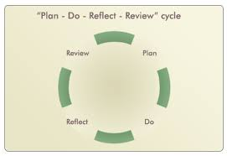
Coding-Proficient
Zero Errors
Self Review
Take time out to do self-review
Look at breaking your code
In every function, identify all possible Error Codes impacting the function
Notes:
Bring out the importance of this activity by giving some real-time examples from your project
Reflect – relook at the need for creating the code and think
- is this code doing what I want
- is this code familiar – is it located elsewhere so I can reuse
- can I break it?
Review
- coding guidelines
- Code complexity

Slide 14
Coding-Proficient
Coding Advanced - Objectives
To be a better developer by being able to:
Code has zero errors in very first attempt
Cyclomatic complexity less than 10 for atleast 70% of code
Written code is easily debugged remotely
To be aware of already available libraries and to be able to use them efficiently
To be able to produce portable code

Slide 15

Coding-Proficient
What do we do to enable debugging remotely
Traces
Trace API to be used
System Trace on/off
Trace feature on/off
Trace level
Brief
Detailed
Trace message
To be able to control Traces remotely

Slide 16
Coding-Proficient
Tracing
The traces may be updated at compile time using a compile time flag or at runtime using:
Command line arguments
A config data file
The different levels of traces may be:
NO_TRACE
BRIEF_TRACE:
DETAILED_TRACE:
Notes:
BRIEF_TRACE:
Major events are logged
The general guideline is that this level will provide just enough information to effectively trace the flow of execution
DETAILED_TRACE:
Major events are logged
Other information like hex dump of entire message (including API headers), action taken, state changes etc

Slide 17
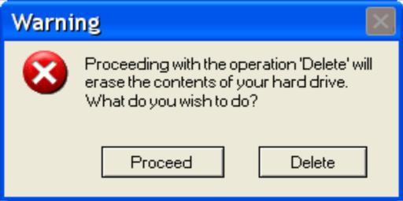
Coding-Proficient
Error Handling
Error Handling
Handling all possible errors
Uniform Error Handling Interface
Error Classification
Notes:
Error handling routine goes hand in hand with tracing – appropriate trace / error messages

Slide 18
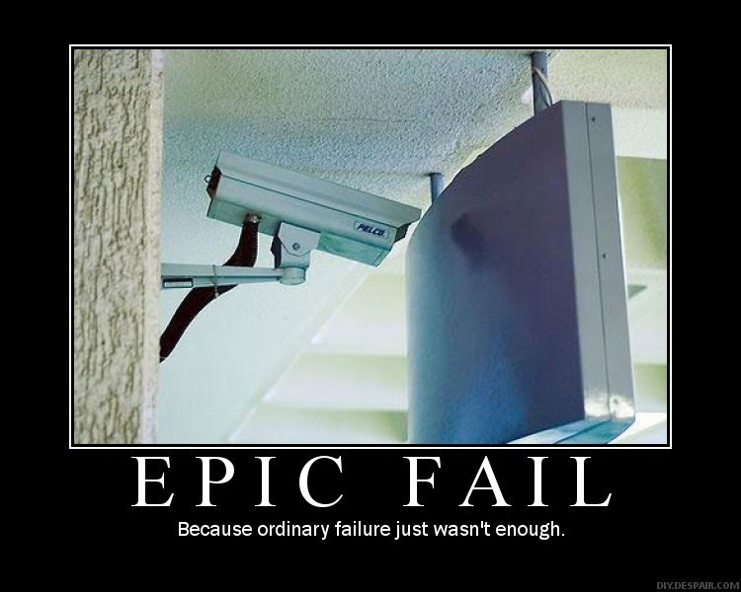
Coding-Proficient
Error Handling – Classification of Errors
Severity of errors can be classified into:
Critical errors
Major errors
Minor errors
Type of errors can be classified into:
Protocol Errors
API Errors
System Error
Notes:
Critical errors which if occur do not allow the system to proceed. E.g. memory allocation is unsuccessful
Major errors which if occur impact a major functionality of the system. E.g. A telecom switch stops logging the start and end of a call thus impacting the billing system
Minor errors which if occur impact a small functionality of the system. E.g. An online exam stops giving remarks (excellent/very good/good/fair/poor) to the participant based on his marks, though the system is giving the marks and percentage
Protocol Errors: Errors which violate a protocol E.g. problems in messages transferred between 2 entities,
API Errors: Errors occurring when an API is invoked by another module. E.g. A particular argument passed to the API is null though it should never be null.
System Error: Errors that are returned by the operating system. E.g. unable to open a socket

Slide 19

Coding-Proficient
Portability
Porting is the process of adapting software so that an executable program can be created for a computing environment that is different from the one for which it was originally designed
Portability means
Across multiple platforms
Across multiple architectures
Across network (Little endian Vs Big Endian)
Notes:
Porting is the process of adapting software so that an executable program can be created for a computing environment that is different from the one for which it was originally designed

Slide 20
Coding-Proficient
Portability – a quick review
Platform specific code
outside world
Core Code
Port code enables the Core code to communicate with the outside world

Slide 21
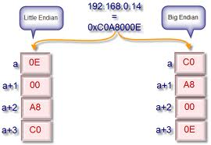
Coding-Proficient
Network Portability
Endianness
Architecture can be big endian or little endian
But the network is always big-endian.
So always convert data to big-endian format before sending
Notes:
Porting is the process of adapting software so that an executable program can be created for a computing environment that is different from the one for which it was originally designed
Demonstrate the embedded “portable code” – Execute the same!
Comment the “htons(port)” (line 38) from “daytime_server.c” and demonstrate again
Discuss network level portability based on this

Slide 22

Coding-Proficient
Portability related Activities
Porting Consists of
Platform Porting
Memory Management
Timer Management
IPC mechanism
Locking mechanism
Porting the API Library
Error Handling
Debug Support
Notes:
Need to touch upon functions with variable number of arguments
Later we will demonstrate the “Anagram” Code – emphasize on portability and tracing.
Also demonstrate the code by disabling the trace. Discuss about the importance of tracing.

Slide 23

Coding-Proficient
Library and Third Party Tools
How to choose a library?
Runs on all the target platforms
Can be compiled easily using the compiler of choice
Has all the modern functions required, but adheres to standard
Is as small as possible
Can easily be pruned to meet the constraints of one’s target system
Notes:
Bring “portability” and non-availability of some libraries in certain systems (embedded, as an example)

Slide 24
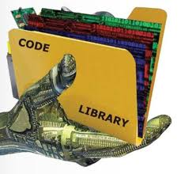
Coding-Proficient
C Standard Library Vs POSIX Library
The C standard library is the standard library for the C programming language, as specified in the ANSI C standard (Currently ISO C Library)
The C POSIX library is a specification of a C standard library for POSIX systems. It was developed at the same time as the ANSI C standard (as a super set!)
Notes:
Bring “portability” and non-availability of some libraries in certain systems (embedded, as an example)

Slide 25
Coding-Proficient
What should you do
Prefer standard libraries like POSIX for your code
If you are new in a project - Read the common library as one of the first things to read
When you create code
Break the code to a low enough level that you can reuse small generic common functions
Communicate to all about the generic code added by you

Slide 26
Coding-Proficient
References
http://www.yolinux.com/TUTORIALS/LinuxTutorialPosixThreads.html
http://programmers.stackexchange.com/questions/65705/how-to-code-faster-without-sacrificing-quality
http://vim.wikia.com/wiki/Cscope

Slide 27
Disclaimer
Disclaimer
Aricent Group makes no representations or warranties with respect to contents of these slides and the same are being provided “as is”. The content/materials in the slides are of a general nature and are not intended to address the specific circumstances of any particular individual or entity. The material may provide links to internet sites (for the convenience of users) over which Aricent Group has no control and for which Aricent Group assumes no responsibility for the availability or content of these external sites. While the attempt has been to acknowledge sources of materials wherever traceable to an individual or an institution; any materials not specifically acknowledged is purely unintentional

Slide 28
Revision History
Revision History
Version No | Date of Release | Author | Approved by | Changes
0.1 | 17th Dec 2013 | Sibu/Shiv | Sibu/Shiv | Initial Draft

